Slide 1
OPPO F3 VS Vivo V5 PLUS
Group 12
Anggista Amalia Yashinta (08)
Farid Aziz Wicaksono (15)

Slide 2
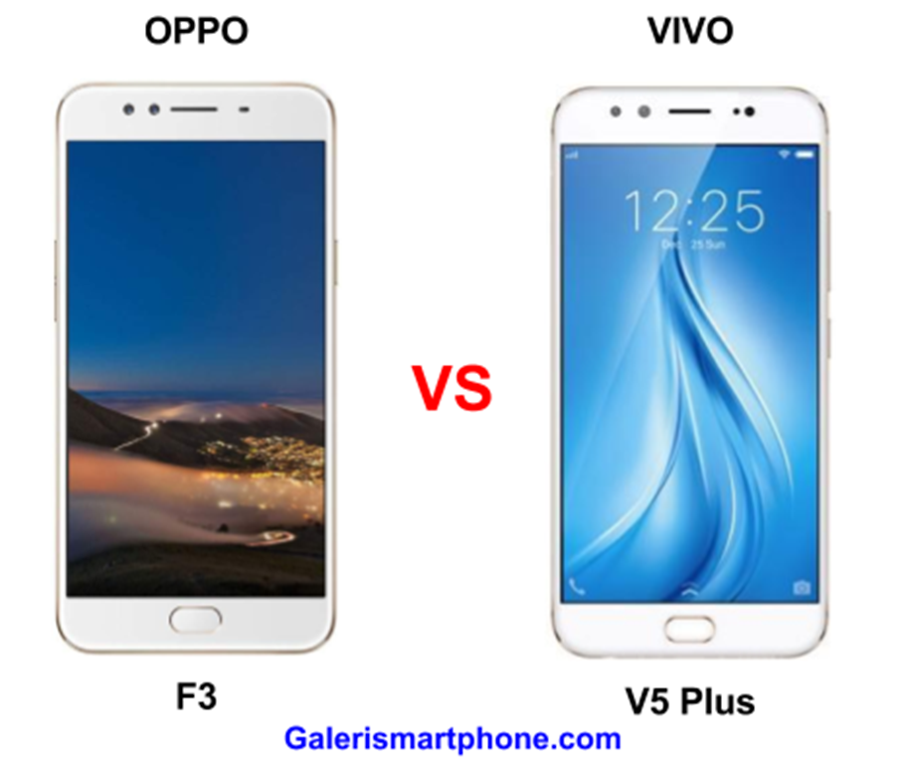

Slide 3
Specification
 | OPPO F3 | Vivo V5 Plus
STATUS | May 13, 2017 (Official) | February 1, 2017 (Official)
Size | 75.2 x 7.3 x 153.3 mm | 152.6 x 74 x 7.3 mm
Storage | 64 GB | 64 GB
Camera | 13 MP | 16 MP
Battery | 3200 mAh | 3055 mAh
Ram | 4 GB | 4 GB
Weight Height Thickness Width | 153 gram 153.3 mm 7.3 mm 75.2 | 158.6 gram 152.5 mm 7.2 mm 74 mm

Slide 4
 | OPPO F3 | Vivo V5 Plus
Processor | Octa core (1.5 GHz, Quad core, Cortex A53 + 1 GHz, Quad core, Cortex A53) | Octa core, 2 GHz, Cortex A53
Screen Size and Type | 5.5 inches (13.97 cm) IPS LCD | 5.5 inches (13.97 cm) IPS LCD
Screen Resolution | Full HD (1080 x 1920 pixels) | Full HD (1080 x 1920 pixels)
Touch Screen | Yes Capacitive Touchscreen, Multi-touch | Yes Capacitive Touchscreen, Multi-touch
Pixel Density | 401 ppi | 401 ppi
Nfc | No | No
Gps | Yes with A-GPS | Yes with A-GPS, Glonass

Slide 5
 | OPPO F3 | Vivo V5 Plus
Network Support | 4G (supports Indian bands), 3G, 2G | 4G (supports Indian bands), 3G, 2G
Sim Size | SIM1: Nano, SIM2: Nano | SIM1: Nano SIM2: Nano
Wifi | Yes Wi-Fi 802.11, a/b/g/n/n 5GHz | Yes Wi-Fi 802.11, a/ac/b/g/n/n 5GHz
Bluetooth | Yes v4.0 | Yes v4.0
Usb Connectivity | Mass storage device, USB charging, microUSB 2.0 | Mass storage device, USB charging, microUSB 2.0
Fingerprint Sensor | Yes | Yes
Other Sensors | Light sensor, Proximity sensor, Accelerometer, Compass | Light sensor, Proximity sensor, Accelerometer, Compass, Gyroscope

Slide 6
 | OPPO F3 | Vivo V5 Plus
Camera Features | Fixed Focus | Digital Zoom, Auto Flash, Face detection, Touch to focus
Image Resolution | 4128 x 3096 Pixels | 4616 x 3464 Pixels
Resolution | 16 MP + 8 MP Dual Front Cameras | 20 MP + 8 MP Dual Front Cameras
Physical Aperture | F2.0 | F2.0
Flash | Yes Screen flash | Yes LED Flash
Shooting Modes | Continuos Shooting, High Dynamic Range mode (HDR) | Continuos Shooting, High Dynamic Range mode (HDR)
Video Recording | 1920x1080 @ 30 fps | 1920x1080 @ 30 fps

Slide 7
conclution
Vivo V5 Plus size is bigger than OPPO F3
Vivo V5 Plus has a selfie camera that is better than OPPO F3
OPPO F3 has a bigger battery than Vivo V5 Plus
Vivo V5 Plus heavier than OPPO F3
Vivo V5 Plus has a better GPS than OPPO F3
Vivo V5 Plus has a Gyroscope sensors, but OPPO F3 didn’t
Vivo V5 Plus has a better image resolution than OPPO F3

Slide 8

THANK YOU

